Slide 1
Select Stars
Emani Jones & Casey Walsh

Slide 2
Our Project
We are sport analysts for Syracuse basketball team
There has been an issue with our recruiting
There was a basketball invitational involving 4 of the best high school basketball teams
Our job is to take the results, from the games played at the invitational to help SU scout players

Slide 3
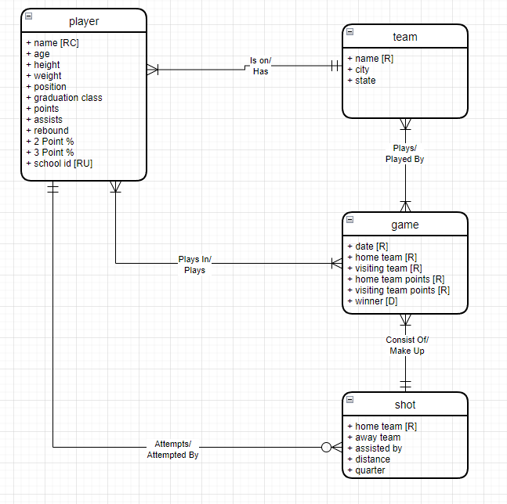
Conceptual Model

Slide 4
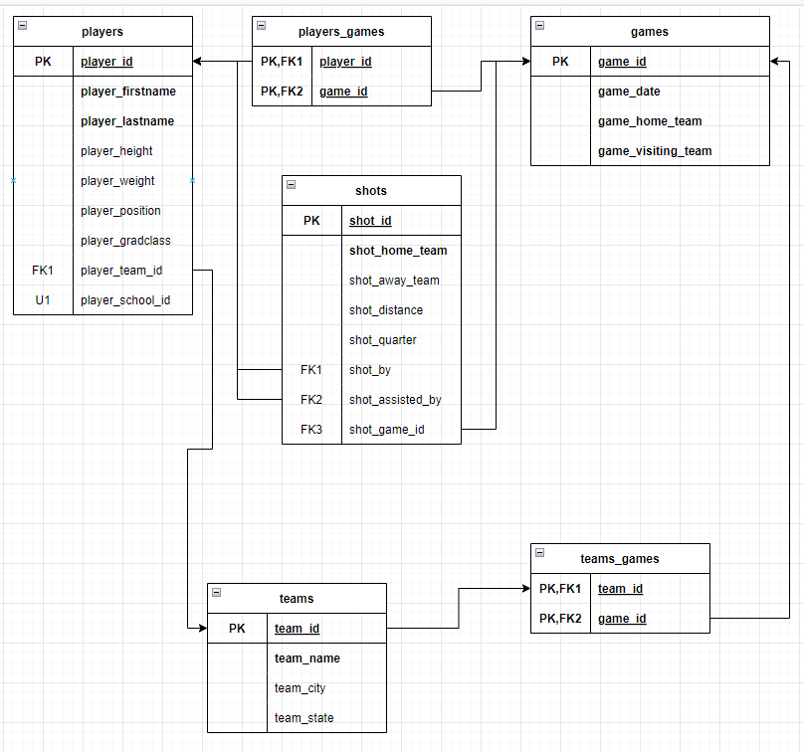
Logical Model

Slide 5
Internal Model
Tables
Players
Teams
Games
Shots
Lookup Tables
Positions
Grade Level
States

Slide 6
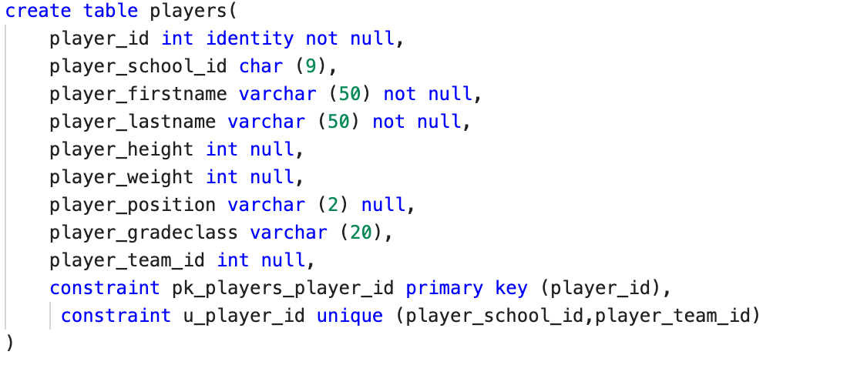
Players

Slide 7
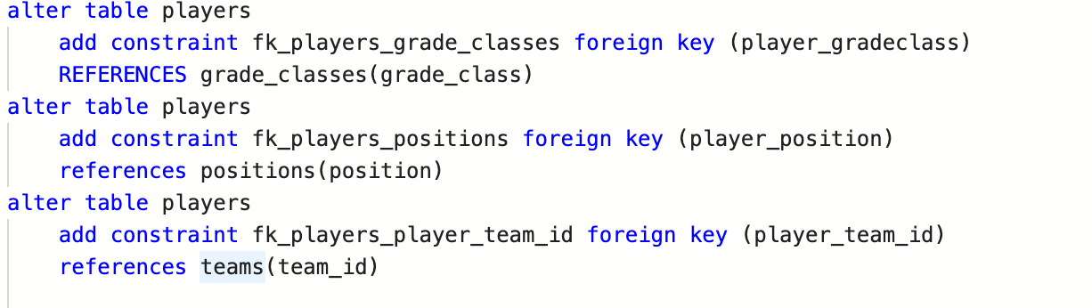
Players ( Foreign Keys)

Slide 8
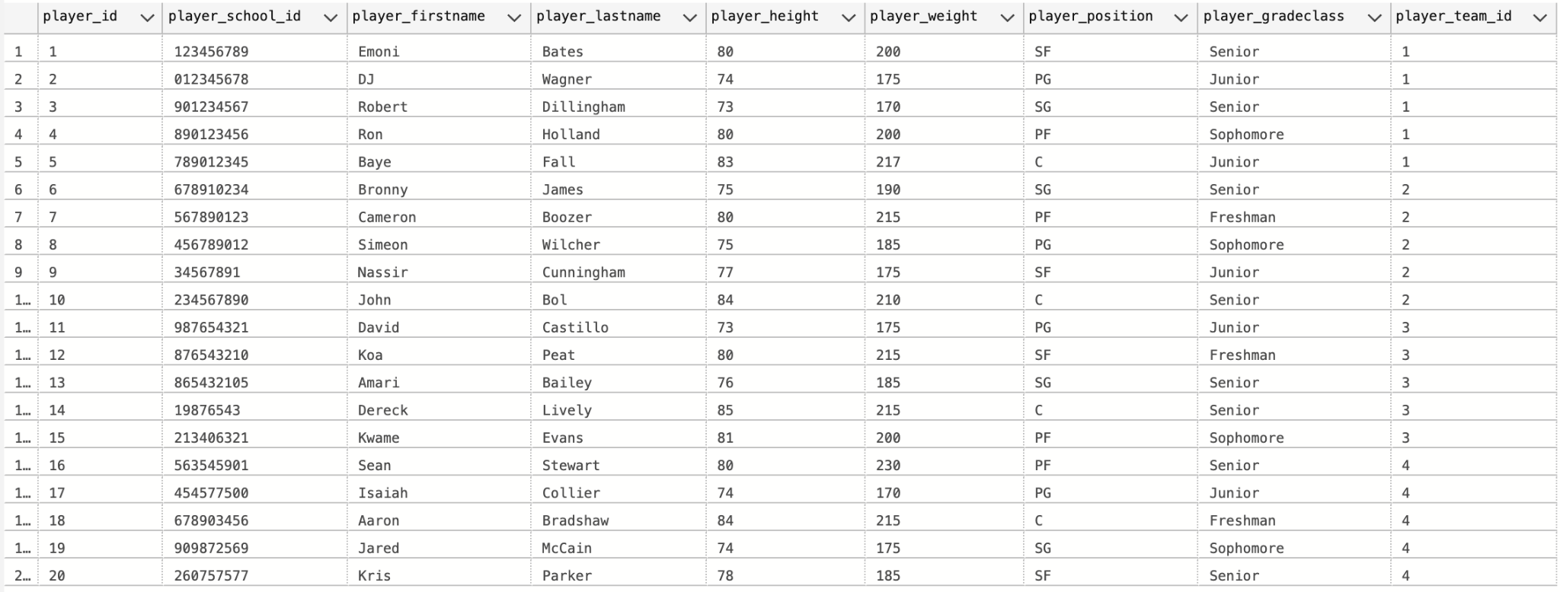
Players Data

Slide 9
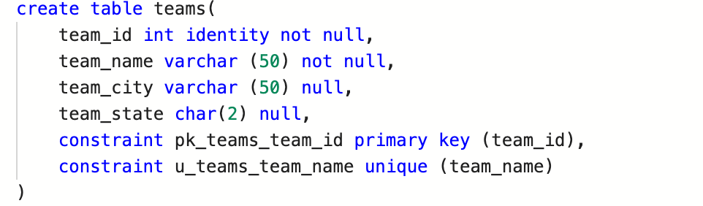
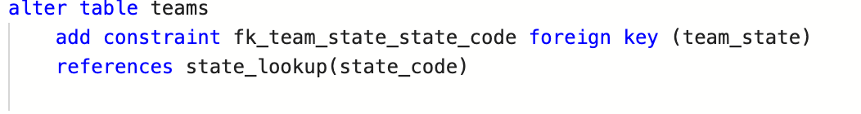
Teams

Slide 10
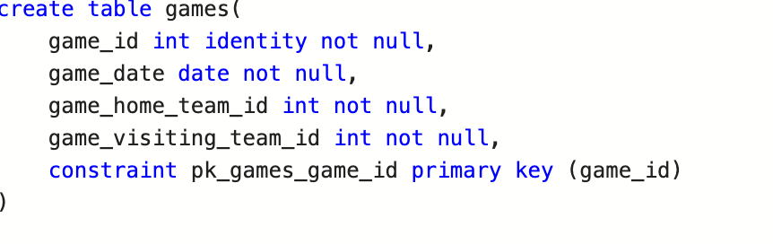
Games

Slide 11
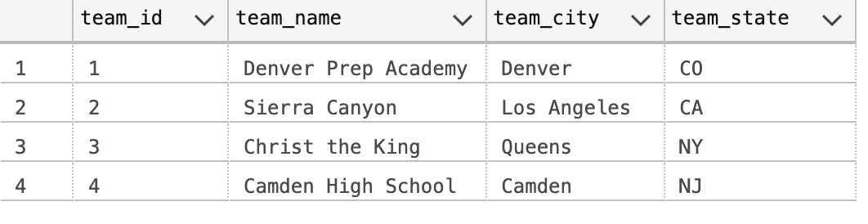
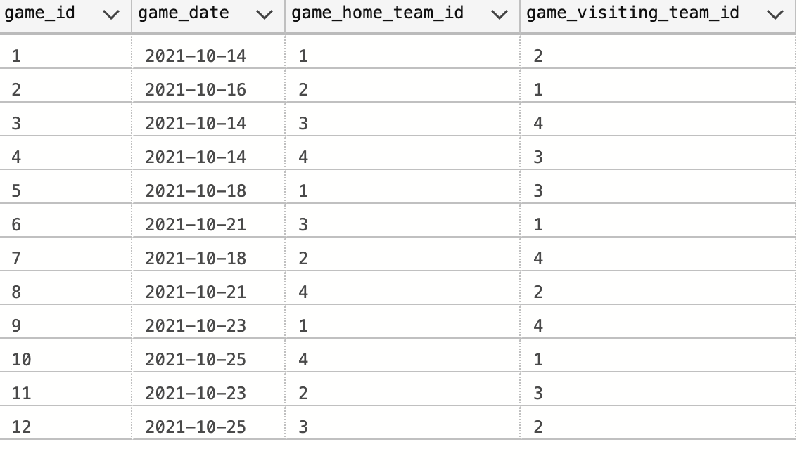
Team and Game Data

Slide 12
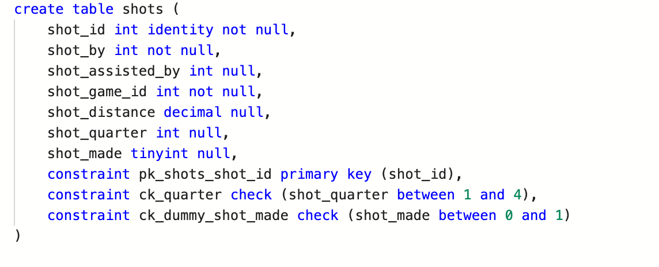
Shots

Slide 13
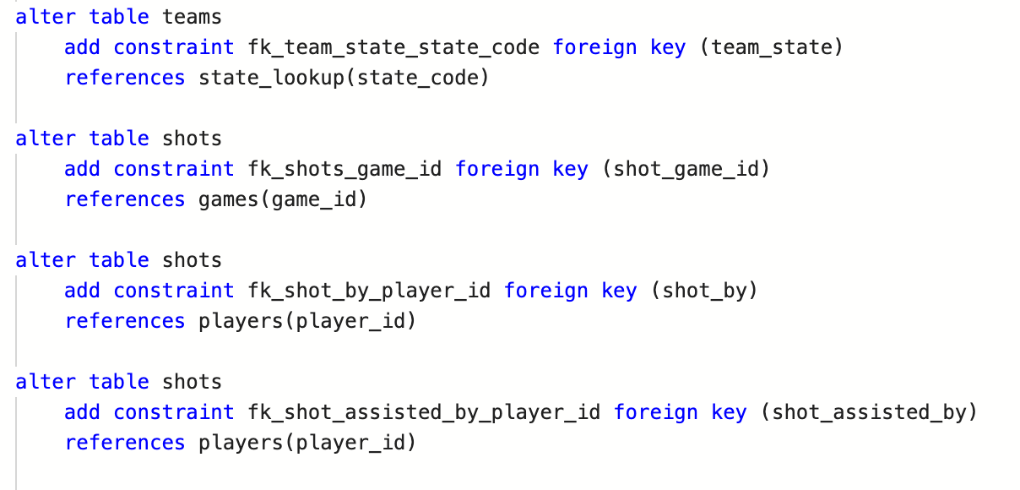
Shots Foreign Key

Slide 14
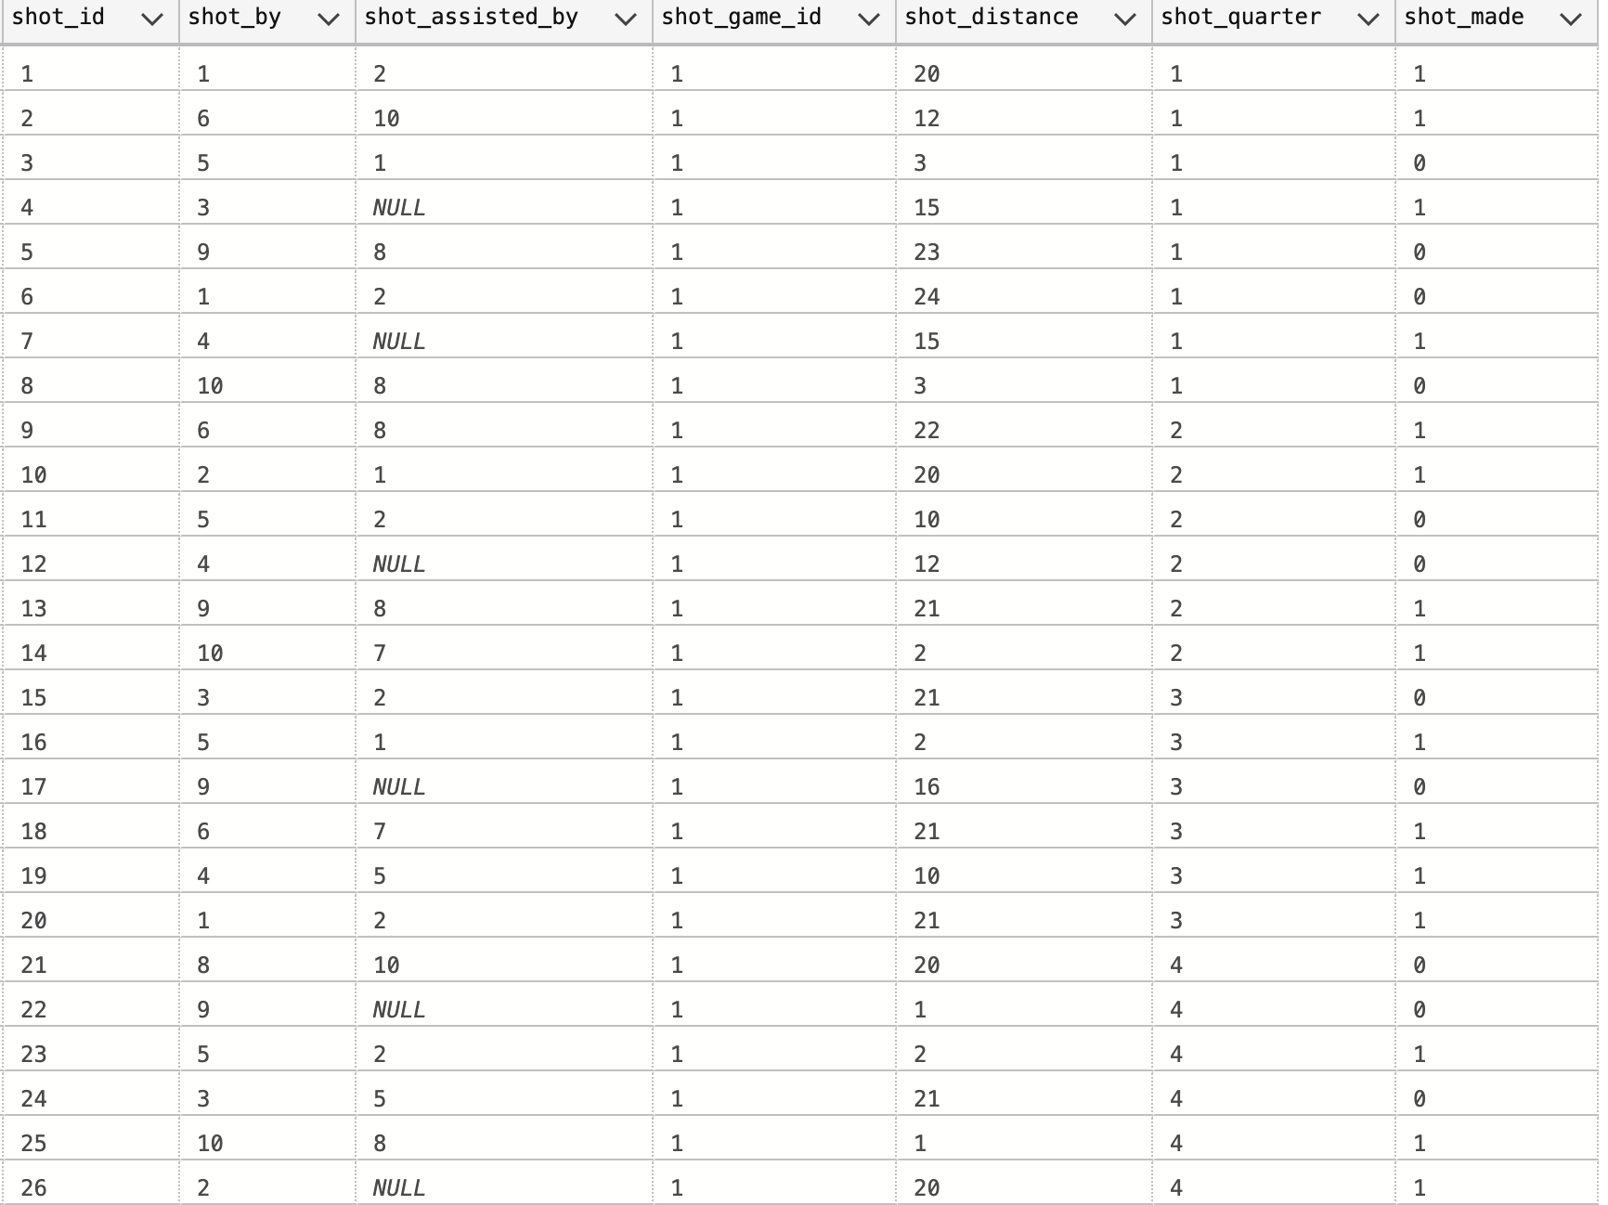
Shots Data

Slide 15
Stored Procedures
p_add_team
p_add_player
p_add_game
p_add_shot
p_transfer_player

Slide 16
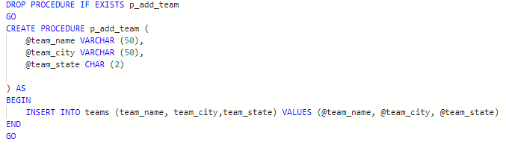
p_add_team

Slide 17
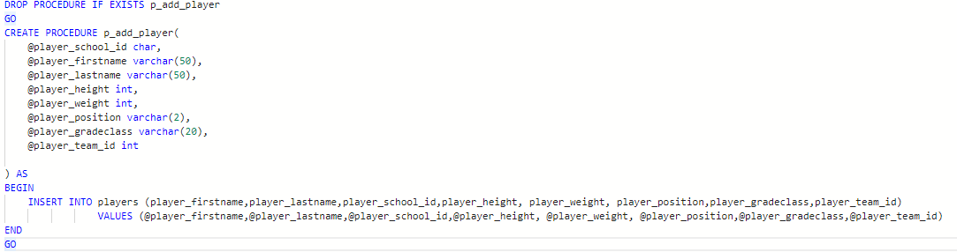
p_add_player

Slide 18
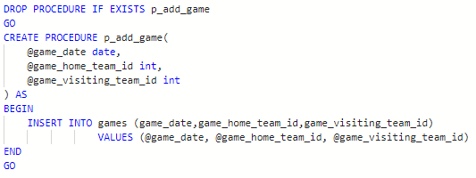
p_add_game

Slide 19
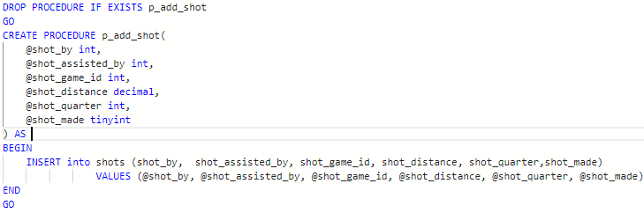
p_add_shot

Slide 20
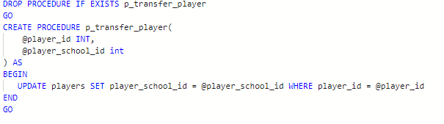
p_transfer_player

Slide 21
Views
v_player_stats
v_team_wins

Slide 22
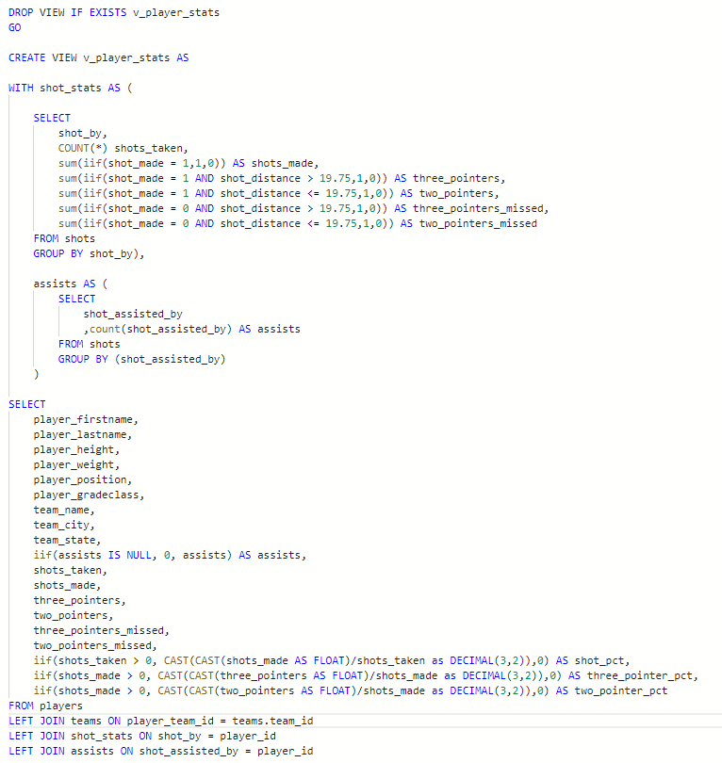
v_player_stats

Slide 23
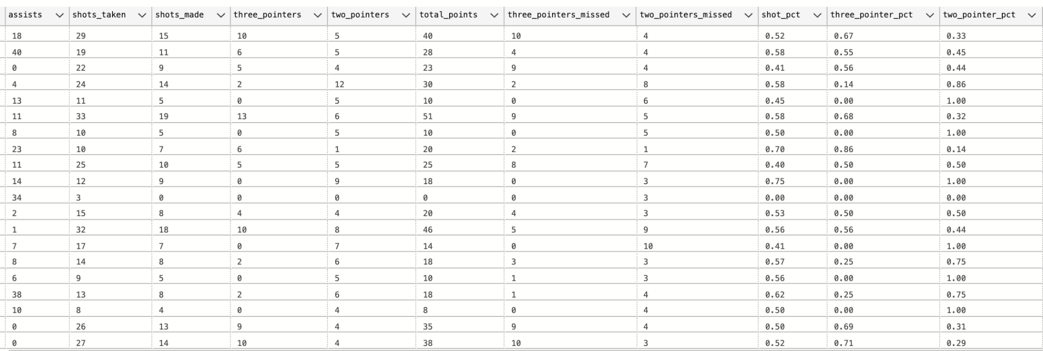
v_player_stats

Slide 24
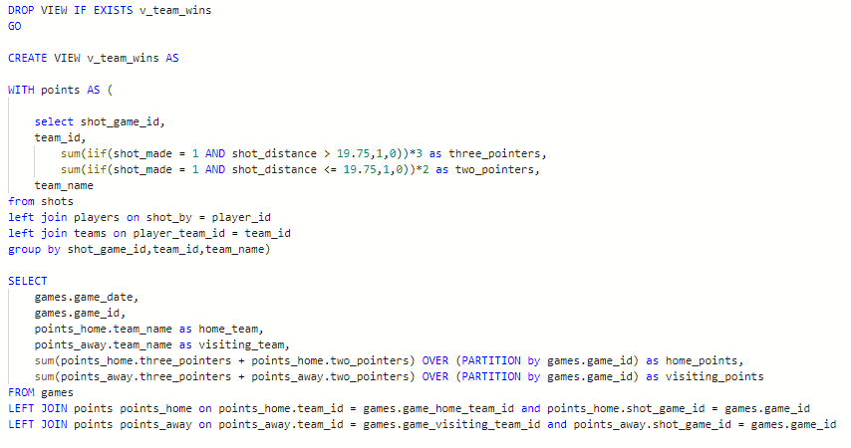
v_team_wins

Slide 25
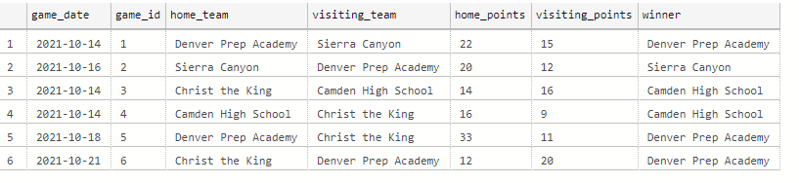
v_team_wins

Slide 26
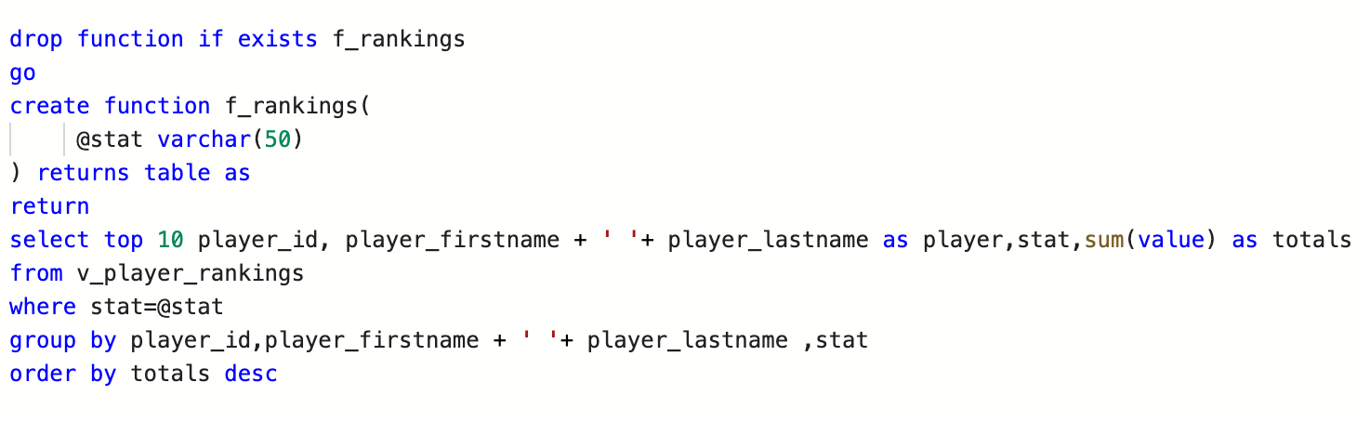
f_rankings

Slide 27
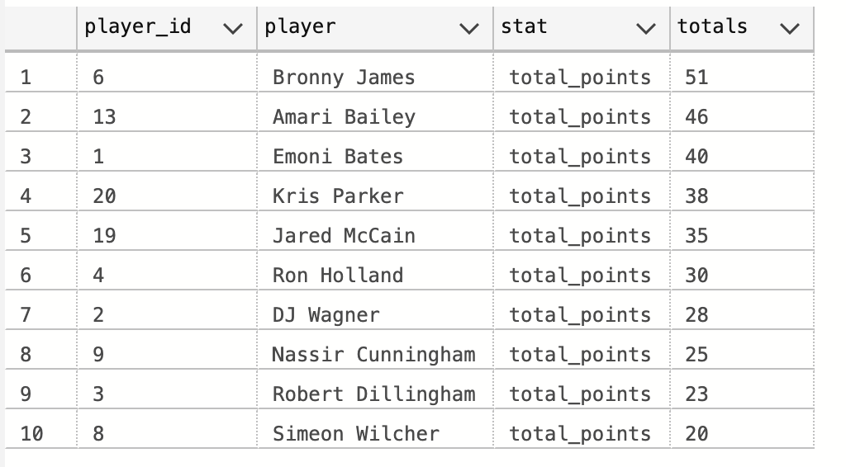
Top 10 - Total Points

Slide 28
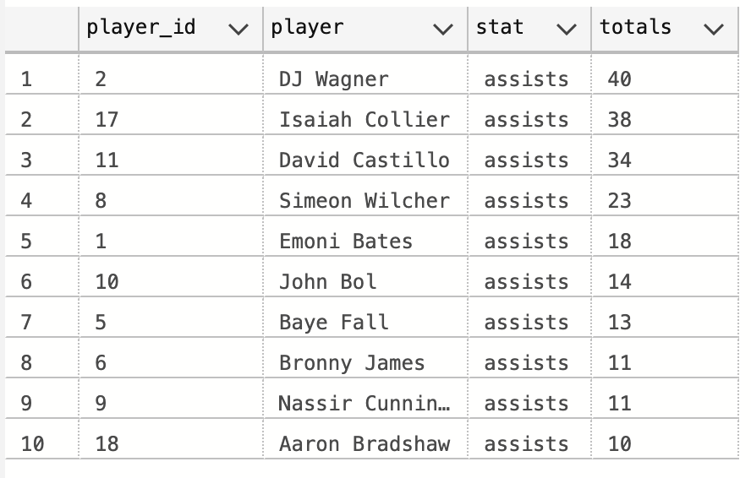
Top 10 - Assists

